Slide 1

राष्ट्रीय प्रौद्योगिकी संस्थान, रायपर
National Institute of Technology Raipur (C.G.)
Department of Information Technology
Project Presentation on
HAND GESTURE ACTIVITIES FOR DIGITAL INTERACTIONS
USING COMPUTER VISION
Under the guidance of:
Dr. Gyanendra Kumar Verma
Assistant Professor Grade I
Dept. of IT
Submitted by:
Nandigama Charanjit
Roll.no : 24265012
Shaik Nisar Ahmad
Roll.no : 24265022

Slide 2
CONTENTS
Introduction
Feasibility Study
Requirement Analysis
Design and Modelling
UML Diagrams
Methodology
Results
References

Slide 3
INTRODUCTION
Project Goal : Build a software system to perform Digital interaction based on Hand Gestures. Digital Interaction like:
Navigating through Documents
Mouse Functionalities
Media Control
Objective :
To enhance user experience and interaction by harnessing hand detection and gesture recognition for seamless digital engagement.

Slide 4

Utilizes webcam input and Python libraries for real-time gesture detection.
This system is cost-effective and can run on any standard machine.
Technical Feasibility
FEASIBILITY
STUDY
Operational
Feasibility
Crafted to seamlessly integrate with existing digital systems, providing flexibility in deployment with minimal added costs.
Economical Feasibility
Cost-effective, leveraging open-source libraries and minimal hardware requirements like camera.

Slide 5
REQUIREMENT ANALYSIS
Software
Requirements
Language : Python
Libraries : OpenCV, pyautogui,
Pynput
Framework : MediaPipe
Hardware
Requirements
Webcam.
computer.
Functional
Requirements
Hand Detection in real time
Perform Digital action based on gestures
Non-Functional
Requirements
Object Oriented Design
Modularity to add further functionalities

Slide 6
DESIGN & MODELING
Data flow between components ensures the user’s gestures are quickly recognized and converted into commands for digital interaction.
Modularity and ease of use with the help of OODesign.
Class Diagram
Activity Diagram
Use Case Diagram
Input Layer
webcam for video capture.
Processing Layer
Gesture detection and Control modules.
Output Layer
Triggers OS controls like mouse actions, Document navigation.

Slide 7
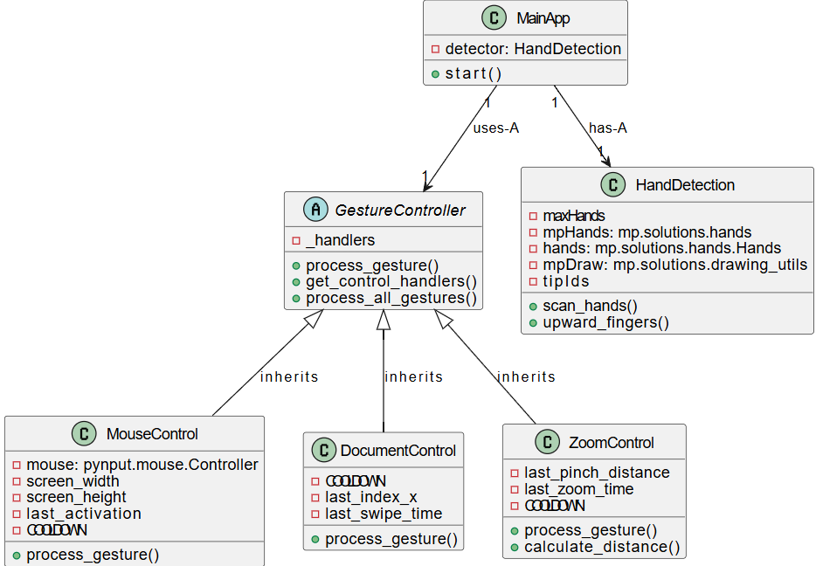
CLASS DIAGRAM

Slide 8
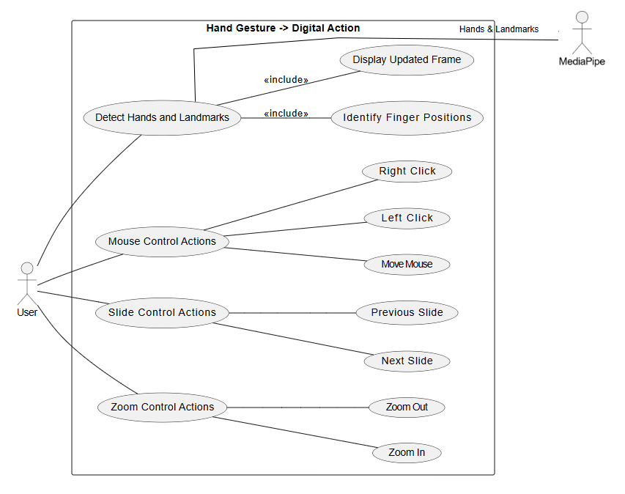
USECASE DIAGRAM

Slide 9
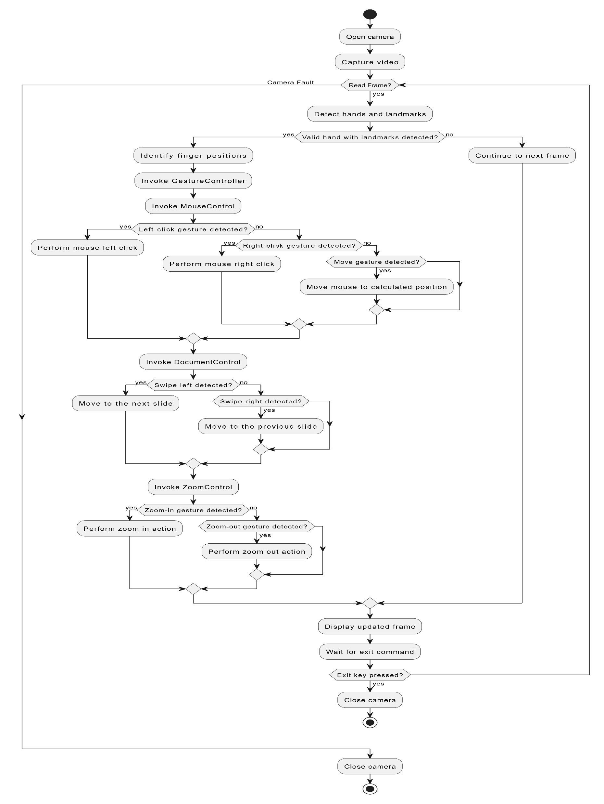
ACTIVITY DIAGRAM

Slide 10
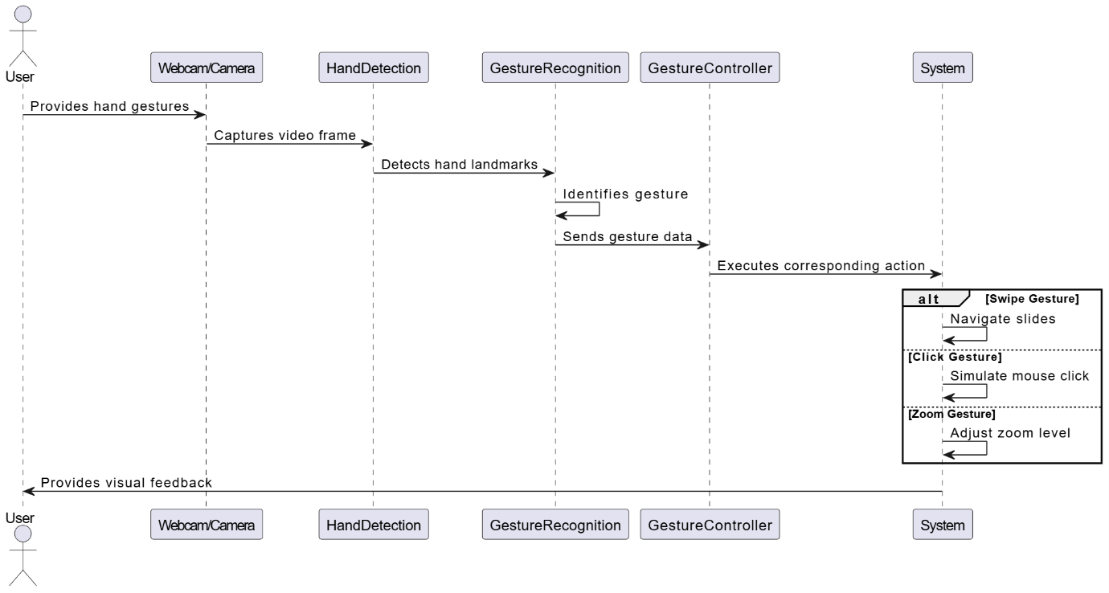
SEQUENCE DIAGRAM

Slide 11
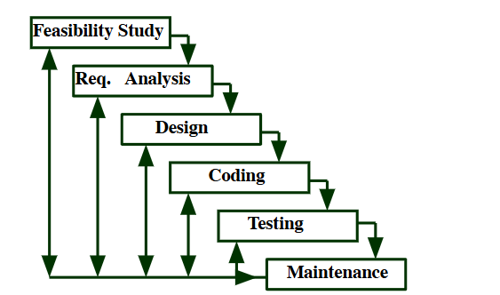
METHODOLOGY
Beginning with Feasibility Study and then Requirement gathering and analysis to identify the essential gestures for digital interaction.
Next, a modular design is created to ensure each gesture.
the hand detection and gesture recognition modules are developed and tested separately.
Each gesture is mapped to system commands.
The approach focuses on accuracy, responsiveness, and usability, ensuring smooth, gesture-based unique digital interaction.

Slide 12





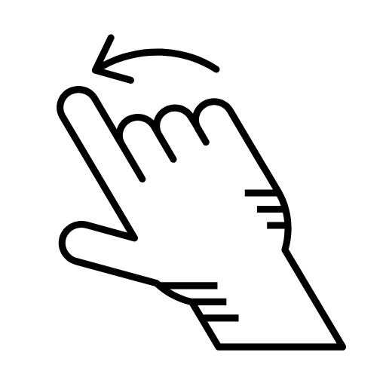

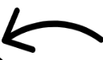



OUTPUT
Mouse pointer movement
Goto Previous Slide
Goto Next Slide
Right Click
Zoom In
Left Click
Zoom Out

Slide 13
RESULTS
HAND GESTURE | DIGITAL INTERACTION
Index Finger, Middle finger Up (Other Fingers Down) | Moves the Mouse Cursor based on hand movements.
Thumb and Middle Finger Up | Simulates a Left Click.
Thumb and Index Finger Up | Simulates a Right Click.
Swipe Left | Moves to the Next Slide or scrolls down in a document.
Swipe Right | Moves to the Previous Slide or scrolls up in a document.
Zoom In Gesture (Index and thumb Moves Away) | Zooms In on the content (e.g., image, document) using pinch gesture.
Zoom Out Gesture (Index and thumb Moves Closer) | Zooms Out on the content using pinch gesture.
All Fingers Closed | Stops any gesture detection or action temporarily.
A high level of accuracy in gesture recognition, with an average success rate of 95% across various gestures.
Users reported that the application significantly improved their interaction experience.
Latency under 100ms, ensuring real-time performance.
Compatibility across various lighting conditions and user gestures.

Slide 14
REFERENCES
Zhang, Z., & Wang, Y. (2020). "A Survey on Gesture Recognition Techniques." Journal of Computer Science and Technology, 35(4), 789-805.
Google. (2021). "MediaPipe: A Framework for Building Perception Pipelines." Retrieved from https://google.github.io/mediapipe/
Kinect for Windows SDK. (2019). "Gesture Recognition with Kinect." Retrieved from
https://www.microsoft.com/en-us/download/details.aspx?id=44561
Le, T. D., & Nguyen, T. H. (2022). "Machine Learning Approaches for Gesture Recognition: A Review." International Journal of Computer Applications, 182(12), 1-8.
E. Almazan, B. Ghanem, S. Moreno, and F. Jurie. “Hand gesture recognition with deep learning,” IEEE Transactions on Pattern Analysis and Machine Intelligence, vol. 37, no. 12, pp. 2523-2535, 2019.
[https://ieeexplore.ieee.org/document/7299406].
MediaPipe Documentation: https://google.github.io/mediapipe
OpenCV Documentation: https://opencv.org/

Slide 15
THANK YOU

